Slide 1
Part 1: Evolutionary Computing
Day 11: Special Data Types
Time Series and Networks
Michael Small
CSIRO-UWA Chair of Complex Engineering Systems
michael.small@uwa.edu.au

Slide 2


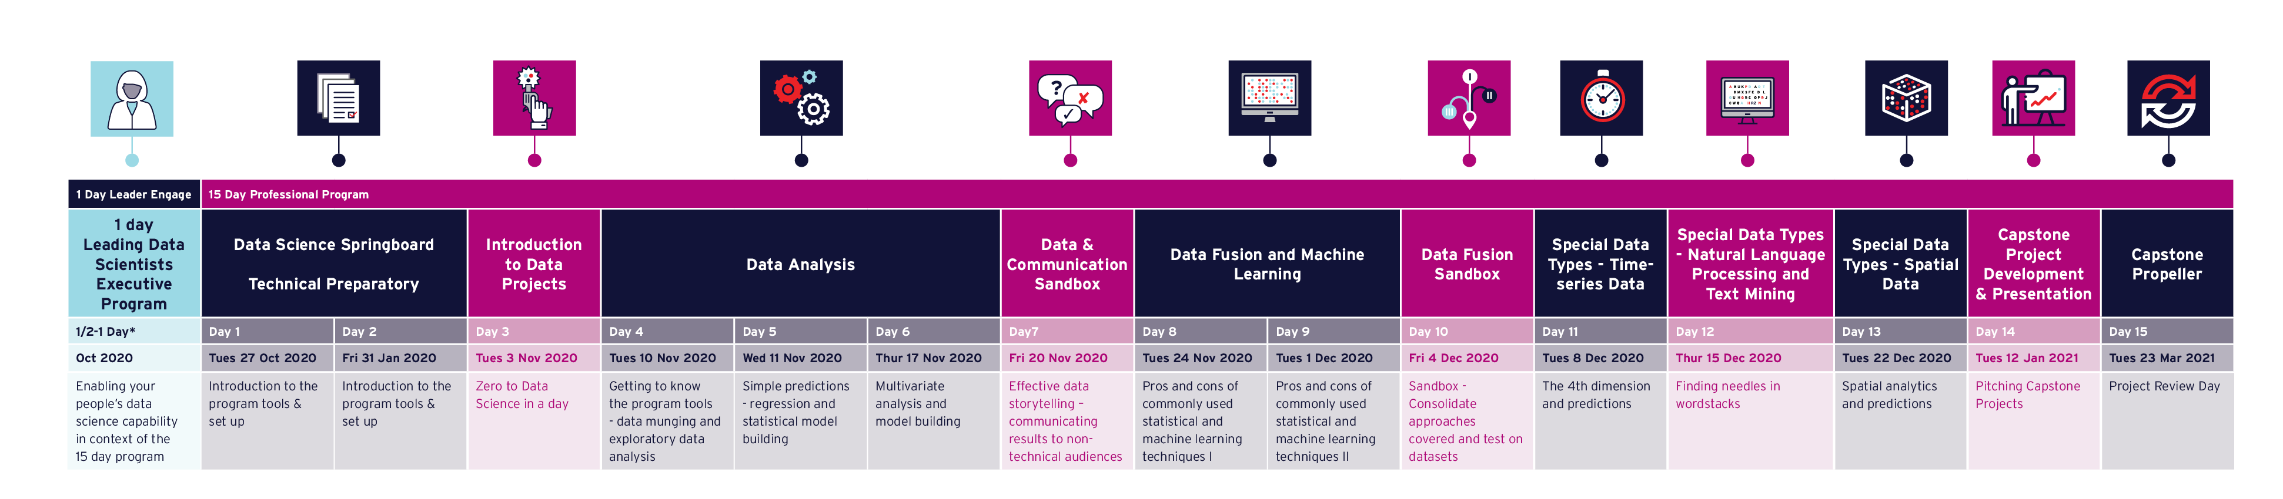
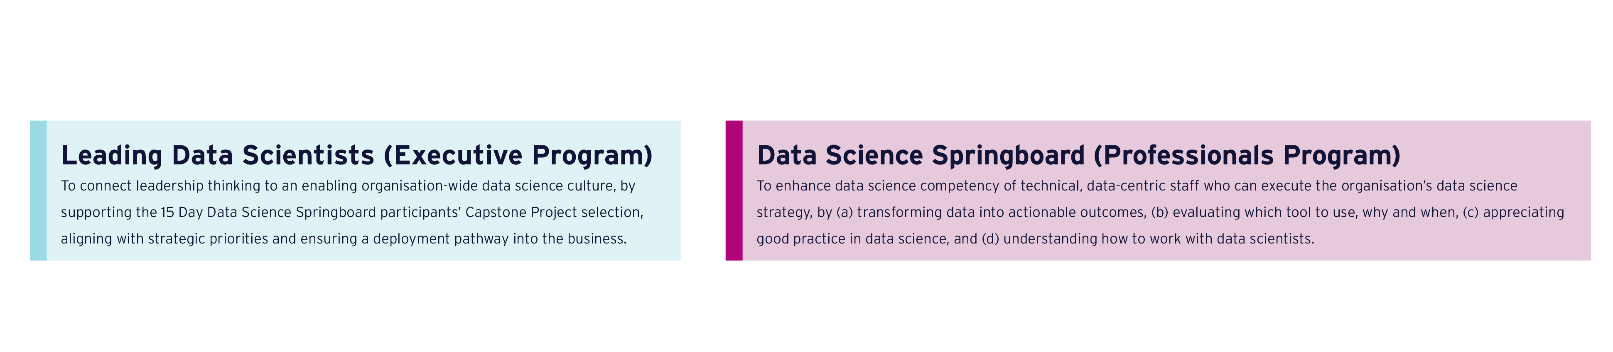
Delivering Data Science to Resources & Energy
Virtual Leader Day and Professional Programs 2020 Perth and Brisbane

Slide 3

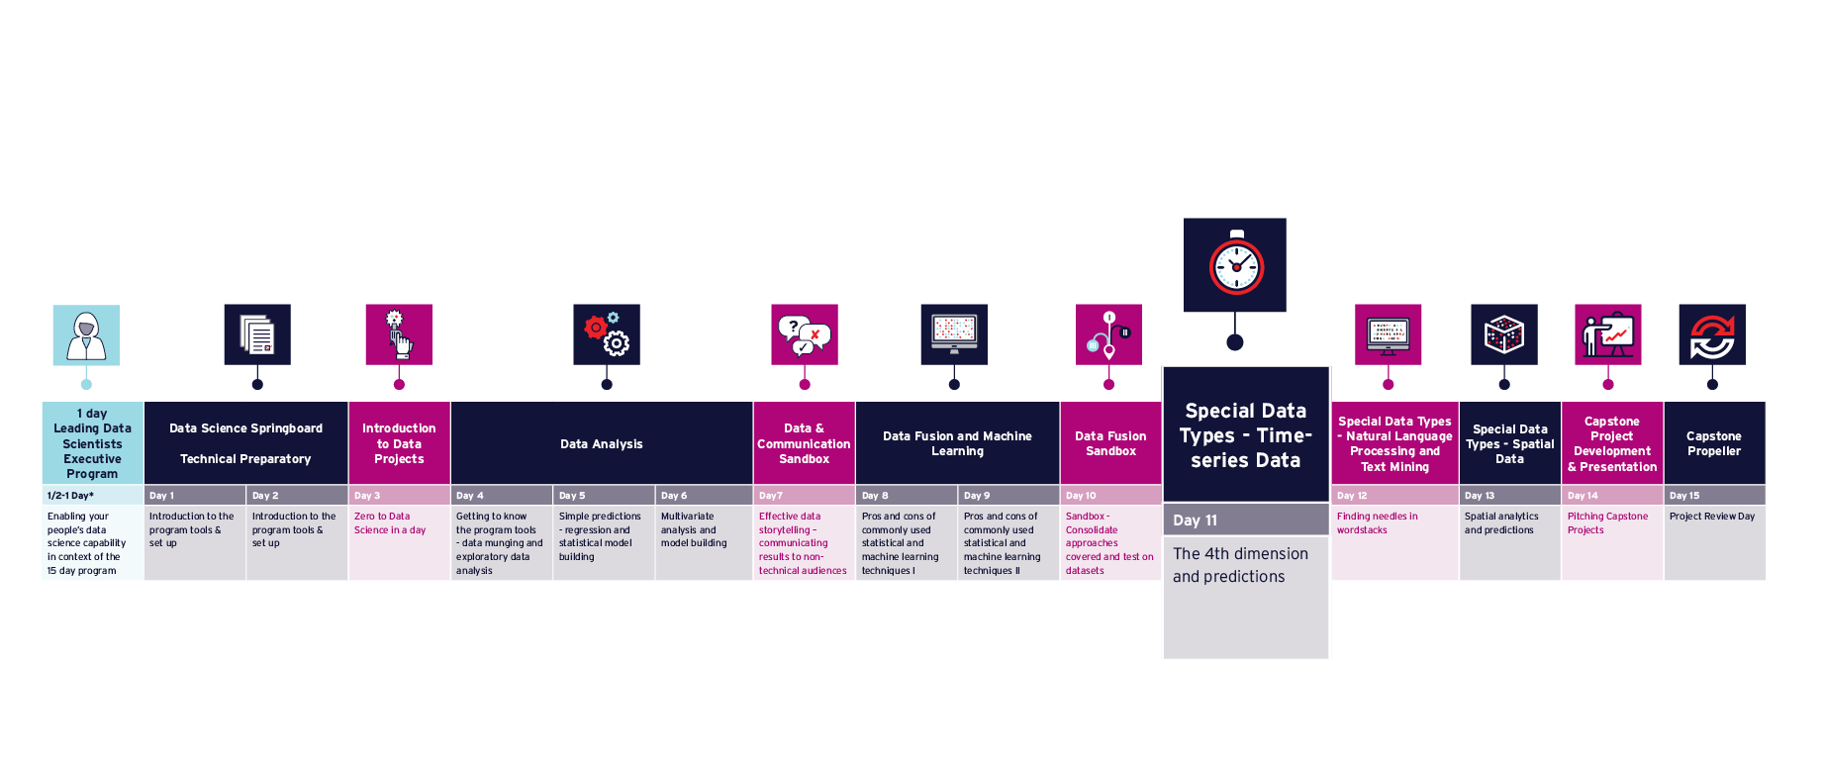
Program Timeline

Slide 4
Plan of the day
AWST | AEST | Agenda
07:30 – 07:45 | 09:30 – 09:45 | Q&A, Issues & Announcements
07:45 – 09:15 | 09:45 – 11:15 | Evolutionary Computing
09:15 – 09:30 | 11:15 – 11:30 | Morning tea
09:30 – 11:00 | 11:30 – 13:00 | Time Series
11:00 – 11:45 | 13:00 – 13:45 | Lunch
11:45 – 13:15 | 13:45 – 15:15 | Networks
13:15 – 13:30 | 15:15 – 15:30 | Afternoon tea
13:30 – 14:45 | 15:30 – 16:45 | Multivariate, Noisy and Nonstationary
14:45 – 15:00 | 16:45 – 17:00 | Closeout

Slide 5
11
Overview of Non-Smooth Optimisation
Basis of modelling from time series data
Introduction to computation on networks
Application to noisy, multivariate, non-stationary data
Familiarity with main techniques required for each of the areas highlighted above
Ability to implement and/or use relevant methods in python

Slide 6
11.0 Overview

Slide 7
11.0 Overview
What is today about?
Dealing with special data types
What is optimisation and why do we need it?
General-purpose optimisation techniques
Time series data: prediction or simulation?
Networks (in python)
Case study: layer detection in geophysical data
What is a “special” data type? What data do you have that is special?
Michael Small, CSIRO & UWA

Slide 8
11.1 Evolutionary Computing

Slide 9
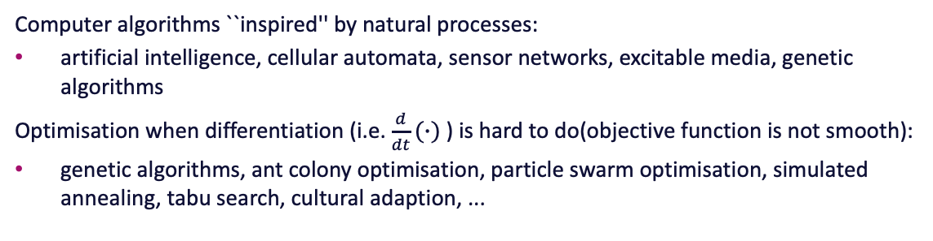
11.1 Evolutionary Computing
Bio-inspired computing
Computer algorithms ``inspired'' by natural processes:
artificial intelligence, cellular automata, sensor networks, excitable media, genetic algorithms
Optimisation when differentiation (i.e. $\frac{d}{dt}(∙)$ ) is hard to do(objective function is not smooth):
genetic algorithms, ant colony optimisation, particle swarm optimisation, simulated annealing, tabu search, cultural adaption, ...
What does optimization mean for your industry?
Michael Small, CSIRO & UWA

Slide 10
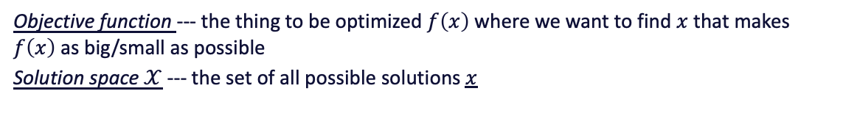
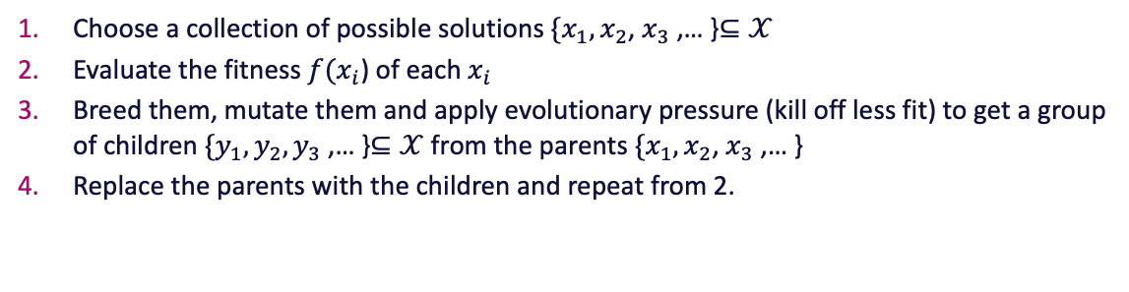
11.1 Evolutionary Computing
Objective function --- the thing to be optimized $f\left(x\right)$ where we want to find $x$ that makes $f\left(x\right)$ as big/small as possible
Solution space $𝒳$ --- the set of all possible solutions $x$
Genetic Algorithm
Choose a collection of possible solutions $\{x_{1},x_{2}$, $x_{3}$,… }$⊆𝒳$
Evaluate the fitness $f(x_{i}$) of each $x_{i}$
Breed them, mutate them and apply evolutionary pressure (kill off less fit) to get a group of children $\{y_{1},y_{2}, y_{3}$,… }$⊆𝒳$from the parents $\{x_{1},x_{2}$, $x_{3}$,… }
Replace the parents with the children and repeat from 2.
Michael Small, CSIRO & UWA

Slide 11
11.1 Evolutionary Computing
Genetic Algorithms
Good for:
difficult to evaluate objective functions
high dimensional systems or non-smooth system
discrete, categorical, or mixed variables
paralellisation
problems when we don't know much about the objective
“modular” problems
Bad for:
smooth problems (use calculus)
stochastic/noisy objective functions
very high dimensional systems
poorly parametrised problems (the “genes” don't work)
Binary/categorical objectives
naiveté
Michael Small, CSIRO & UWA

Slide 12
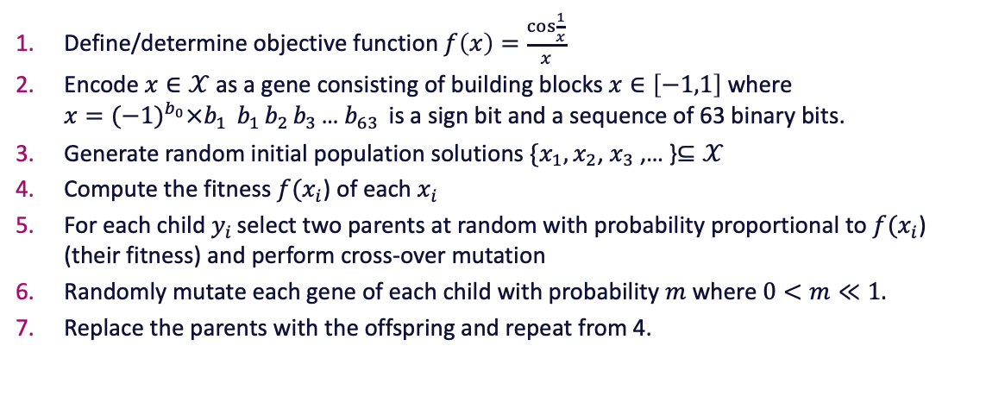
11.1 Evolutionary Computing
Implementation (example)
Define/determine objective function $f\left(x\right)=\frac{\cos{\frac{1}{x}}}{x}$
Encode $x∈𝒳$as a gene consisting of building blocks $x∈\left[−1,1\right]$ where $x{=(−1)}^{b_{0}}×b_{1 }$ $b_{1 }b_{2 }b_{3 }$… $b_{63 }$is a sign bit and a sequence of 63 binary bits.
Generate random initial population solutions $\{x_{1},x_{2}$, $x_{3}$,… }$⊆𝒳$
Compute the fitness $f(x_{i}$) of each $x_{i}$
For each child $y_{i }$select two parents at random with probability proportional to $f(x_{i}$) (their fitness) and perform cross-over mutation
Randomly mutate each gene of each child with probability $m$ where $0<m≪1.$
Replace the parents with the offspring and repeat from 4.
Michael Small, CSIRO & UWA

Slide 13
11.1 Evolutionary Computing
Pythonification
DIY is probably best, but if you insist:
GAFT (on github)
DEAP (on github)
pyevolve (on github)
Pyvolution (pypl.org)
Michael Small, CSIRO & UWA

Slide 14
11.1 Evolutionary Computing
Exercise
Examine the provided code.
What effect does mutation have on the speed of result?
Modify to preserve the fittest
2D optimisation problem
optimise networks and/or time series models
Michael Small, CSIRO & UWA

Slide 15
11.1 Evolutionary Computing
References
Travelling salesman in python https://towardsdatascience.com/evolution-of-a-salesman-a-complete-genetic-algorithm-tutorial-for-python-6fe5d2b3ca35
Clinton Sheppard ``Genetic Algorithms with Python''.
https://www.codeproject.com/Articles/1104747/Introduction-to-Genetic-Algorithms-with-Python-Hel also by Clinton Sheppard
Michael Small, CSIRO & UWA

Slide 16
11.2 Time Series

Slide 17
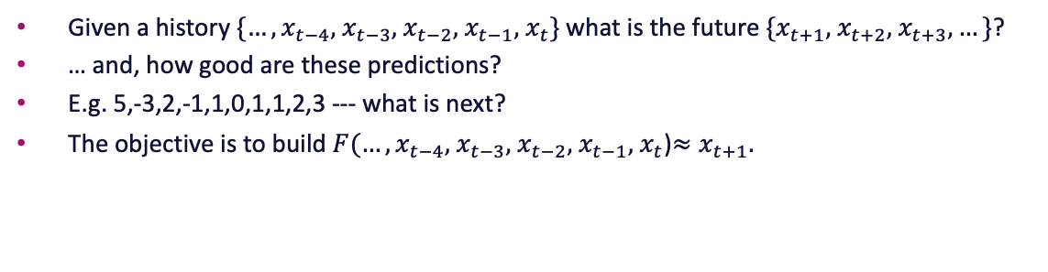
11.2 Time Series
Prediction
Given a history $\{…, x_{t−4},$ $x_{t−3},$ $x_{t−2},$ $x_{t−1},$ $x_{t}\}$ what is the future $\{x_{t+1},$ $x_{t+2},$ $x_{t+3},…\}$?
… and, how good are these predictions?
E.g. 5,-3,2,-1,1,0,1,1,2,3 --- what is next?
The objective is to build $F(…, x_{t−4},$ $x_{t−3},$ $x_{t−2},$ $x_{t−1},$ $x_{t}$)$≈x_{t+1}.$
When would you need prediction in your industry? Prediction of what?
Michael Small, CSIRO & UWA

Slide 18
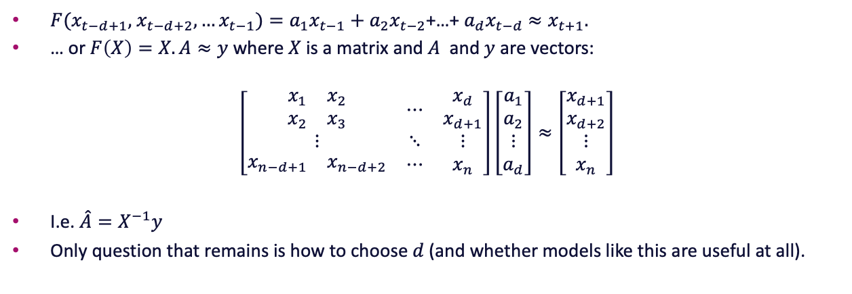
11.2 Time Series
Linear autoregressive models
$F(x_{t−d+1},$ $x_{t−d+2},…x_{t−1})=a_{1}x_{t−1}+a_{2}x_{t−2}$+…+ $a_{d}x_{t−d}$ $≈x_{t+1}.$
… or $F\left(X\right)=X.A≈y$ where $X$ is a matrix and $A$ and $y$ are vectors:
$$\left[\begin{matrix}\begin{matrix}x_{1} & x_{2} \\ x_{2} & x_{3}\end{matrix} & ⋯ & \begin{matrix}x_{d} \\ x_{d+1}\end{matrix} \\ ⋮ & ⋱ & ⋮ \\ \begin{matrix}x_{n−d+1} & x_{n−d+2}\end{matrix} & ⋯ & x_{n}\end{matrix}\right]\left[\begin{matrix}\begin{matrix}a_{1} \\ a_{2}\end{matrix} \\ ⋮ \\ a_{d}\end{matrix}\right]≈\left[\begin{matrix}\begin{matrix}x_{d+1} \\ x_{d+2}\end{matrix} \\ ⋮ \\ x_{n}\end{matrix}\right]$$
I.e. $\hat{A}=X^{−1}y$
Only question that remains is how to choose $d$(and whether models like this are useful at all).
Michael Small, CSIRO & UWA

Slide 19
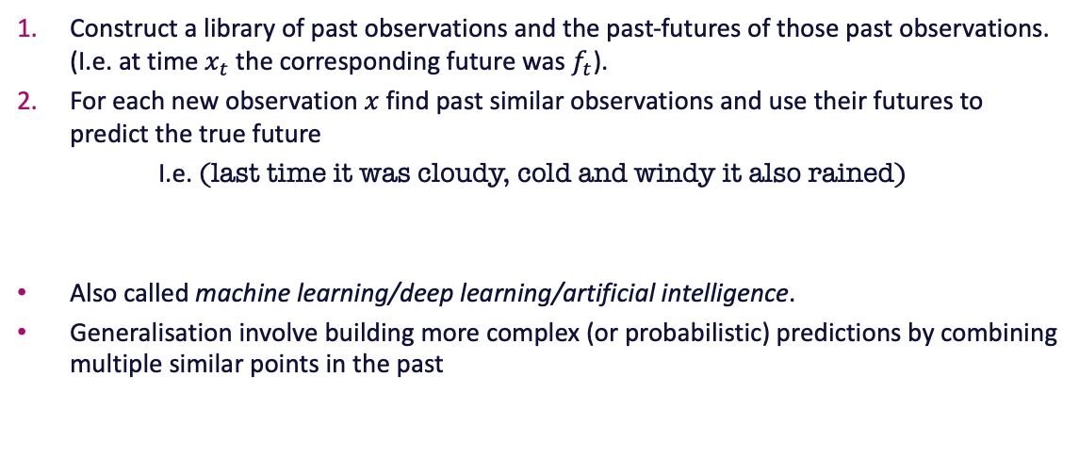
11.2 Time Series
Local modelling --- “Weather Forecasting”
Construct a library of past observations and the past-futures of those past observations. (I.e. at time $x_{t}$ the corresponding future was $f_{t}$).
For each new observation $x$ find past similar observations and use their futures to predict the true future
I.e. (last time it was cloudy, cold and windy it also rained)
Also called machine learning/deep learning/artificial intelligence.
Generalisation involve building more complex (or probabilistic) predictions by combining multiple similar points in the past
Michael Small, CSIRO & UWA

Slide 20
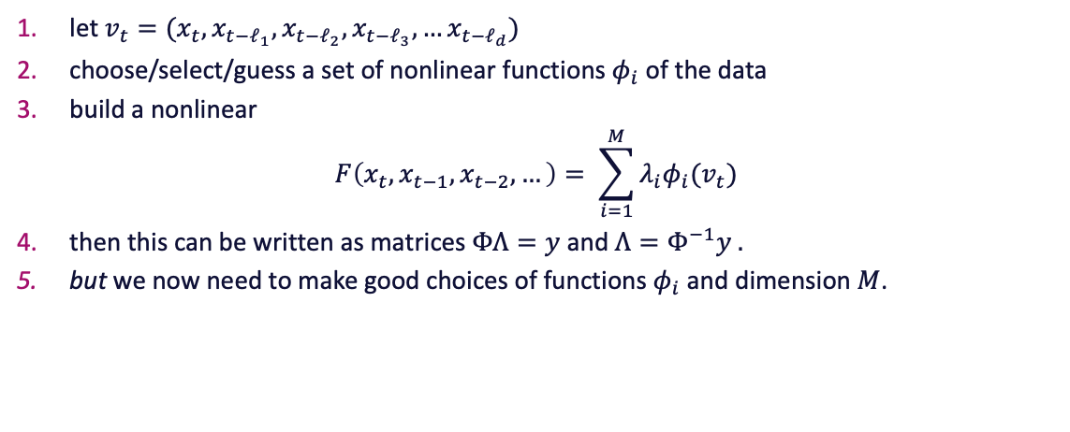
Nonlinear global models
let $v_{t}=(x_{t},x_{t−ℓ_{1}},x_{t−ℓ_{2}},x_{t−ℓ_{3}},…x_{t−ℓ_{d}})$
choose/select/guess a set of nonlinear functions $φ_{i}$of the data
build a nonlinear
$$F\left(x_{t},x_{t−1},x_{t−2},…\right)= \sum_{i=1}^{M}{λ_{i}φ_{i}(v_{t})}$$
then this can be written as matrices $ΦΛ=y$ and $Λ=Φ^{−1}y .$
but we now need to make good choices of functions $φ_{i}$ and dimension $M$.
Michael Small, CSIRO & UWA

Slide 21
11.2 Time Series
Pythonification
An exercise for the reader…
Do this.
Which prediction schemes work best?
When and why?
Michael Small, CSIRO & UWA

Slide 22
11.2 Time Series
References
H. Kantz, T. Schreiber. ``Nonlinear time series analysis'' CUP.
M. Small. ``Applied Nonlinear time series analysis'' World Scientific.
https://towardsdatascience.com/time-series-analysis-in-python-an-introduction-70d5a5b1d52a
https://jakevdp.github.io/PythonDataScienceHandbook/03.11-working-with-time-series.html
Michael Small, CSIRO & UWA

Slide 23
11.3 Networks

Slide 24
11.3 Networks
Exploring your LinkedIn Network
Log into LinkedIn and go to Me->Settings and Privacy->Privacy->How LinkedIn uses your data->Getting a copy of your data
Enter your details and Download archive (it’ll take a while)
Credit: towardsdatascience.com
You’ll need this file at the end of this session.
Michael Small, CSIRO & UWA

Slide 25
11.3 Networks
Discussion
Where do you have networks in your business?
Michael Small, CSIRO & UWA

Slide 26
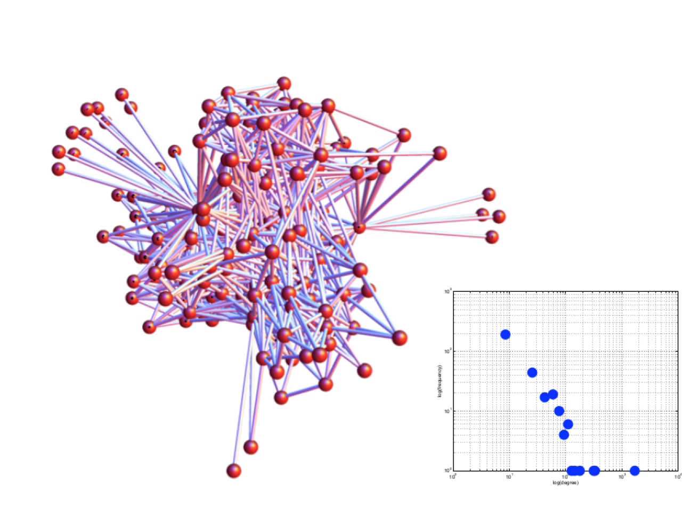
11.3 Networks
Network Quantification
Degree sequence
Degree histogram
Path-length
Clustering
Assortativity
Betweenness Centrality
Eigenvalue Centralitiy
Modularity and Communities
Hubs and richclubs
Robustness and fragility
Motifs and superfamily
Michael Small, CSIRO & UWA

Slide 27
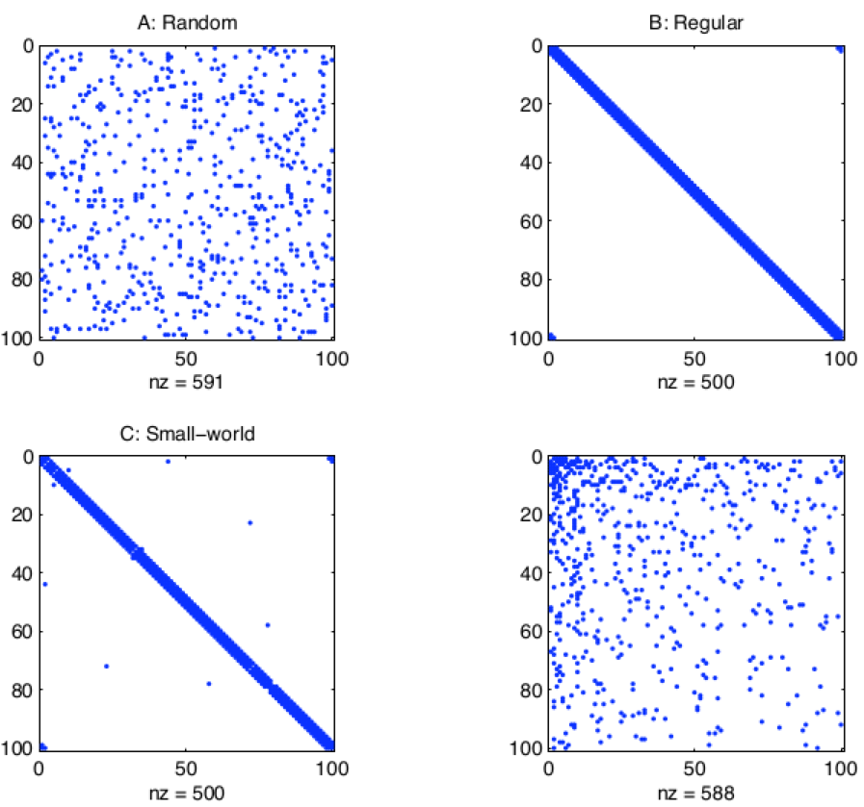
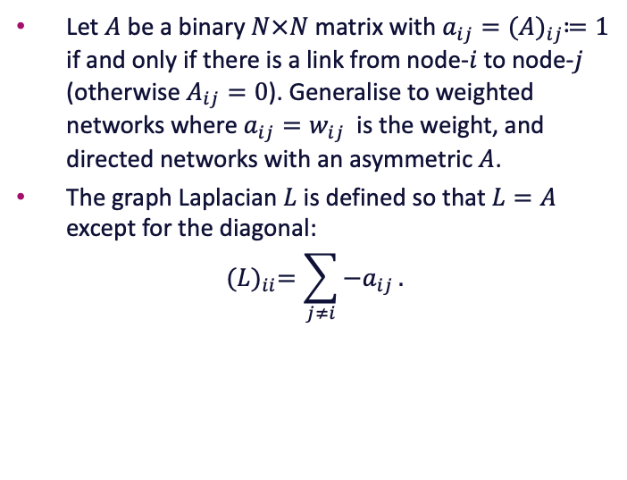
11.3 Networks
Adjacency Matrix
Let $A$ be a binary $N×N$ matrix with $a_{ij}={(A)}_{ij}≔1$ if and only if there is a link from node-$i$ to node-$j$ (otherwise $A_{ij}=0$). Generalise to weighted networks where $a_{ij}=w_{ij}$ is the weight, and directed networks with an asymmetric $A$.
The graph Laplacian $L$ is defined so that $L=A$ except for the diagonal:
$${(L)}_{ii}=\sum_{j≠i}{−a_{ij}}.$$
Michael Small, CSIRO & UWA

Slide 28
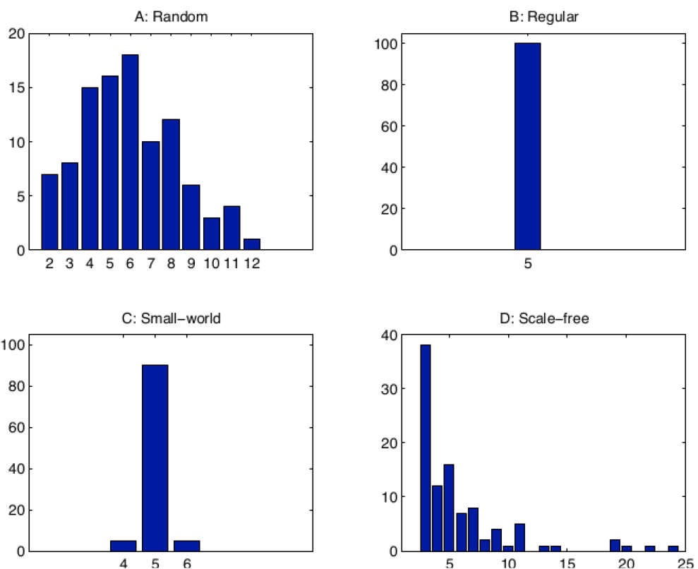
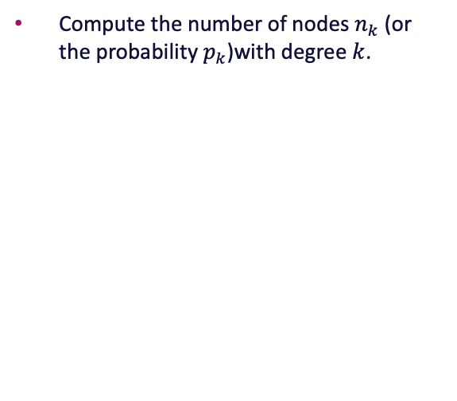
11.3 Networks
Degree Distribution
Compute the number of nodes $n_{k}$ (or the probability $p_{k}$)with degree $k$.
Michael Small, CSIRO & UWA

Slide 29
11.3 Networks
Path-length
Path-length: The path-length is the shortest path (number of edges traversed) between two nodes.
Diameter: The maximum path-length
Michael Small, CSIRO & UWA

Slide 30
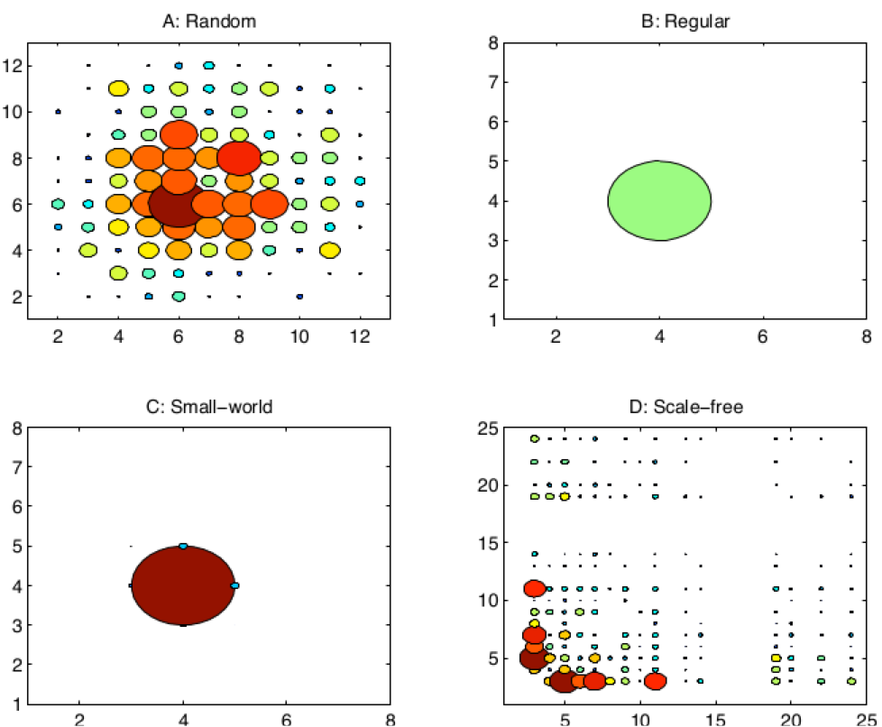
11.3 Networks
Clustering and Assortativity
Clustering: The number of triangles --- the probability of neighbours being neighbours.
Assortativity: The linear (Pearson) correlation between pairs of nodes with a give property
Michael Small, CSIRO & UWA

Slide 31
11.3 Networks
Centrality
Betweenness Centrality: The number (fraction) of shorter paths passing through a given node
Eigenvalue Centrality: (AKA: Google's PageRank) Eigenvalue decomposition of the Laplacian
Michael Small, CSIRO & UWA

Slide 32
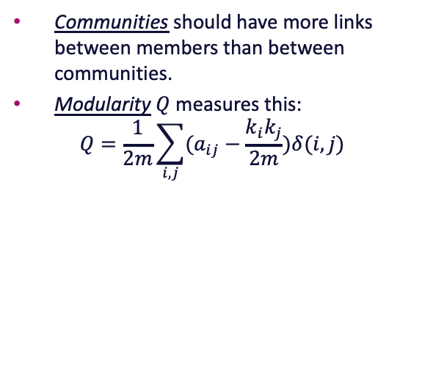
11.3 Networks
Community Detection
Communities should have more links between members than between communities.
Modularity$Q$ measures this:
$$Q=\frac{1}{2m}\sum_{i,j}{(a_{ij}−\frac{k_{i}k_{j}}{2m})δ(i,j)}$$
Michael Small, CSIRO & UWA

Slide 33
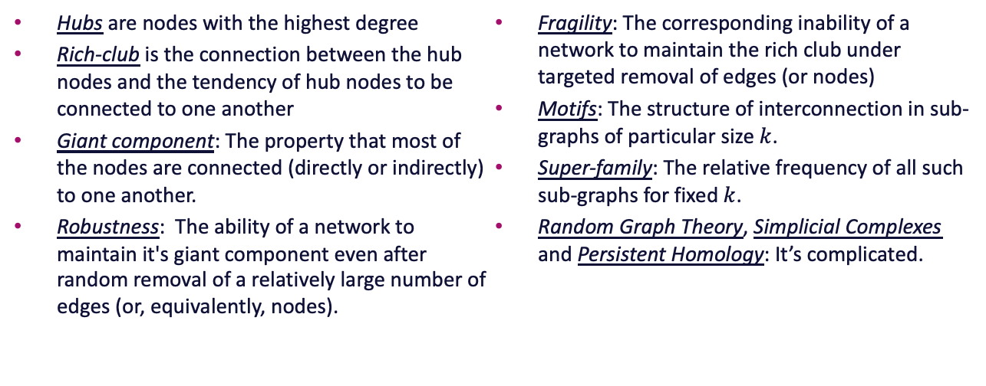
11.3 Networks
Pile Higher and Deeper
Hubs are nodes with the highest degree
Rich-club is the connection between the hub nodes and the tendency of hub nodes to be connected to one another
Giant component: The property that most of the nodes are connected (directly or indirectly) to one another.
Robustness: The ability of a network to maintain it's giant component even after random removal of a relatively large number of edges (or, equivalently, nodes).
Fragility: The corresponding inability of a network to maintain the rich club under targeted removal of edges (or nodes)
Motifs: The structure of interconnection in sub-graphs of particular size $k$.
Super-family: The relative frequency of all such sub-graphs for fixed $k$.
Random Graph Theory, Simplicial Complexes and Persistent Homology: It’s complicated.
Michael Small, CSIRO & UWA

Slide 34
11.3 Networks
Discussion
Why would you need to know any of this stuff for your business?
Pythonification
Everything we've discussed here is implemented and easily usable within the networkx package. Refer to the notebook
Michael Small, CSIRO & UWA

Slide 35
11.3 Networks
References
C. Braham and M. Small. ``Complex networks untangle competitive advantage in Australian football'' Chaos 28 (2018) 053105.
Barabasi, Network Science, http://networksciencebook.com/
https://www.python-course.eu/networkx.php
M. Small. Dynamics of biological systems (network chapter).
Michael Small, CSIRO & UWA

Slide 36
11.35 Case studies

Slide 37

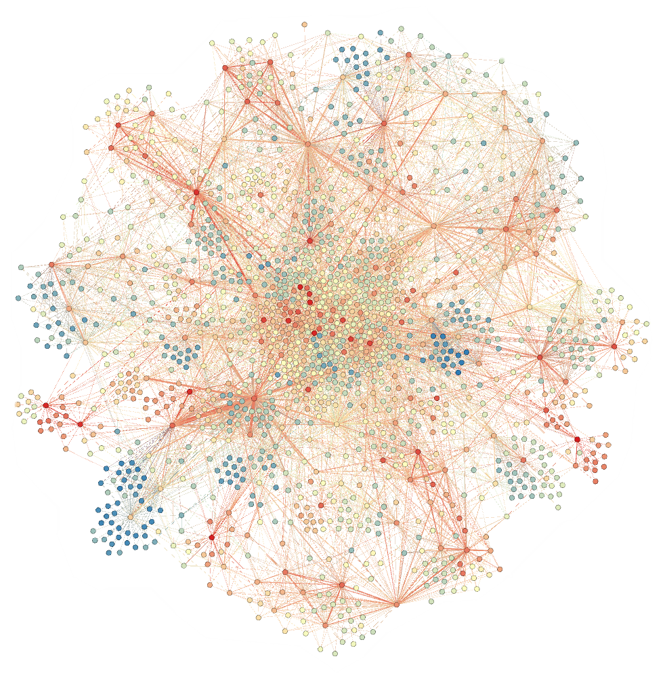
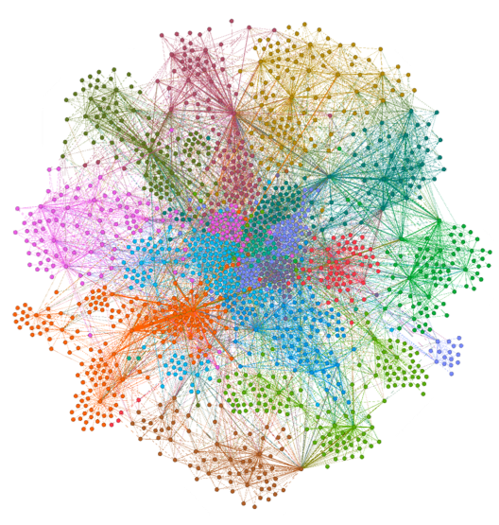
11.35 Networks: Case Studies
Maintenance Data
SAP-based maintenance work orders
Categorised based on likely/possible coincidence
Clustered to groups and observe systemic cascading failure
Michael Small, CSIRO & UWA

Slide 38
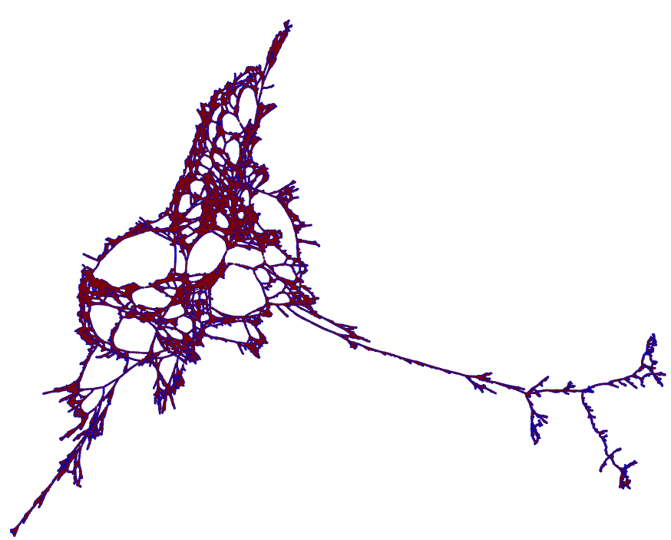
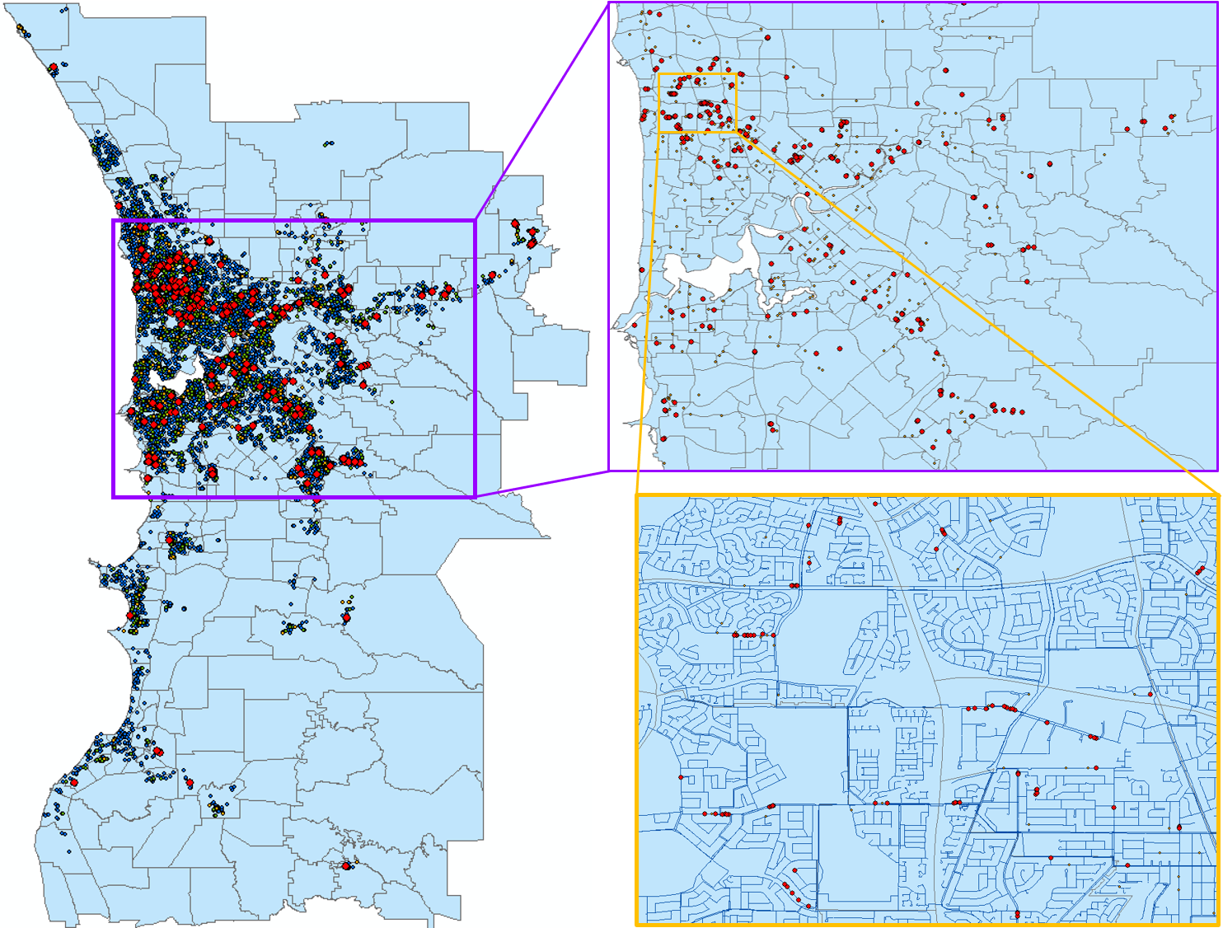
11.35 Networks: Case Studies
Geographically distribute pipe failure
Pipe failure maintenance work orders
Pipe failures form a spatial distribution network
Do connected pipes fail together?
Statistical null hypothesis required
Michael Small, CSIRO & UWA

Slide 39
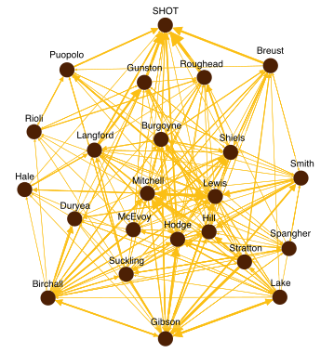
11.35 Networks: Case Studies
Cooperative dynamics in a (AFL) Football team
Network of play-connected players
Measures of dynamics “performance/efficiency” of teams
Effective predictor of match outcome
Michael Small, CSIRO & UWA

Slide 40
11.4 Multivariate, Noisy and Nonstationary

Slide 41
11.4 Multivariate, Noisy and Nonstationary
Multivariate: multiple measures, several variables that represent complex system or phenomena.
Noisy: errors in data collection, storage and processing which are meaningless information.
Nonstationary: mean and variance change over time, difficult to model and predict.
Where and when do you face such type of data in your industry? Everywhere, always?
Michael Small, CSIRO & UWA

Slide 42
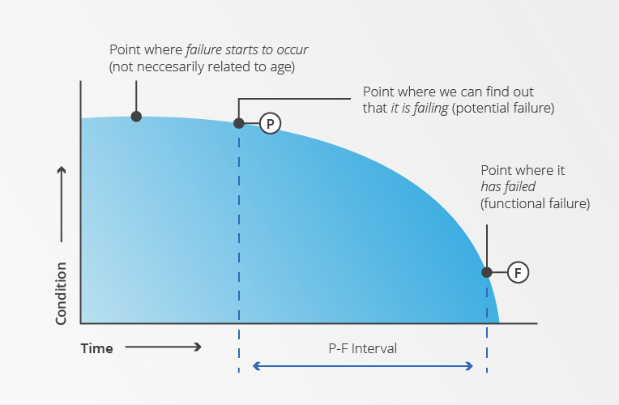
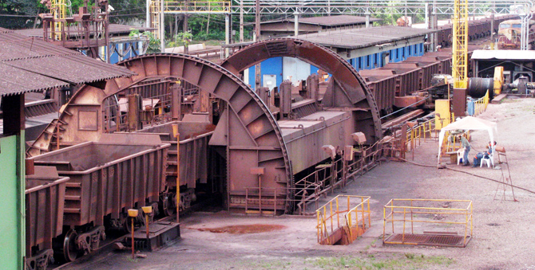
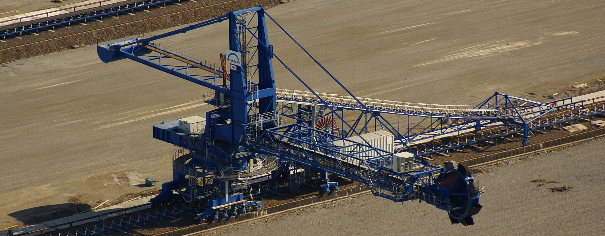
11.4 Motivation: Detect transition in multivariate, noisy and nonstationary data
Source: http://lase.de
Source: http://maintworld.com
Predictive
Proactive
Reactive
Objective: Develop a tool to allow early detection (prediction) of failures from condition/performance (nearly) real-time monitoring.
Source: http://tenova.com
Michael Small, CSIRO & UWA

Slide 43
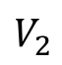
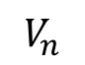
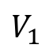
11.4 Motivation: Detect transition in multivariate, noisy and nonstationary data
?
Tipping points
?
Failure event
$$V_{1}$$
?
$$V_{2}$$
Features
$$V_{n}$$
Different modes??
Michael Small, CSIRO & UWA

Slide 44
11.4 Type of transitions
Type 1: State transition
Type 2: Dynamic transition
Michael Small, CSIRO & UWA

Slide 45
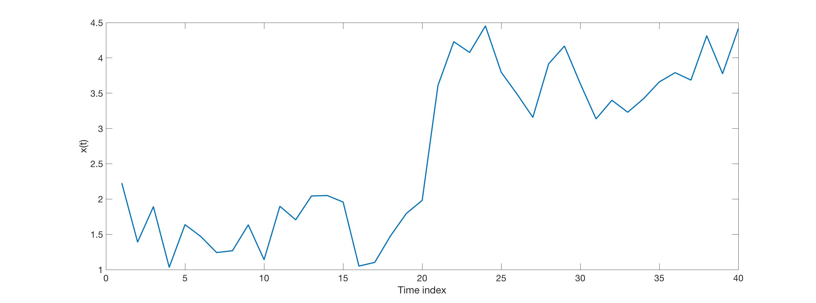
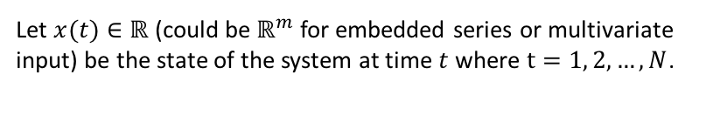
11.4 Recurrence Plot and Quadrant Scan to detect transition
Let $x(t)∈ℝ$ (could be $ℝ^{m}$ for embedded series or multivariate input) be the state of the system at time $t$where $t=1, 2, …,N$.
Michael Small, CSIRO & UWA

Slide 46
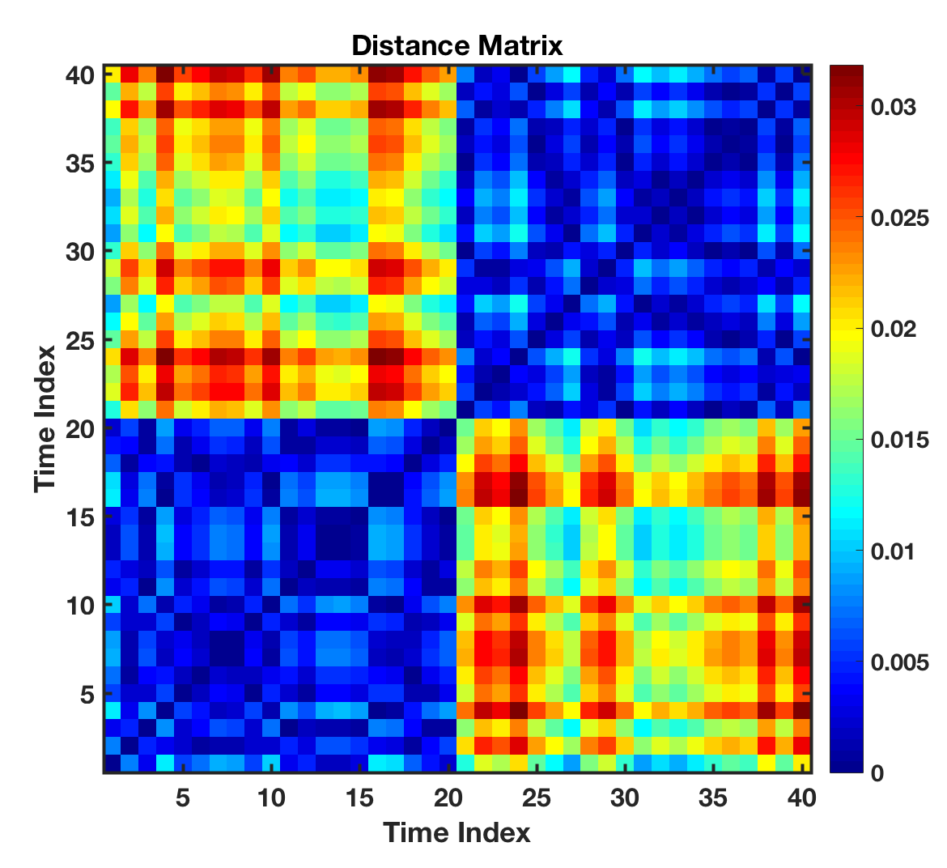
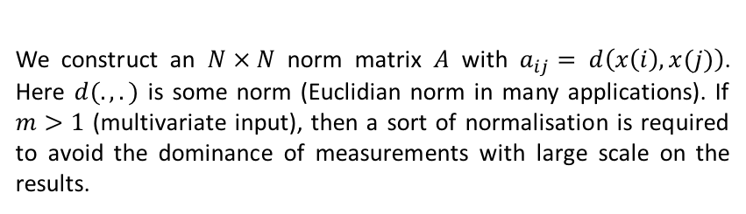
11.4 Recurrence Plot and Quadrant Scan to detect transition
We construct an $N × N$ norm matrix $A$ with $a_{ij}=$ $d\left(x\left(i\right),x(j)\right)$. Here $d(.,.)$ is some norm (Euclidian norm in many applications). If $m>1$ (multivariate input), then a sort of normalisation is required to avoid the dominance of measurements with large scale on the results.
Michael Small, CSIRO & UWA

Slide 47
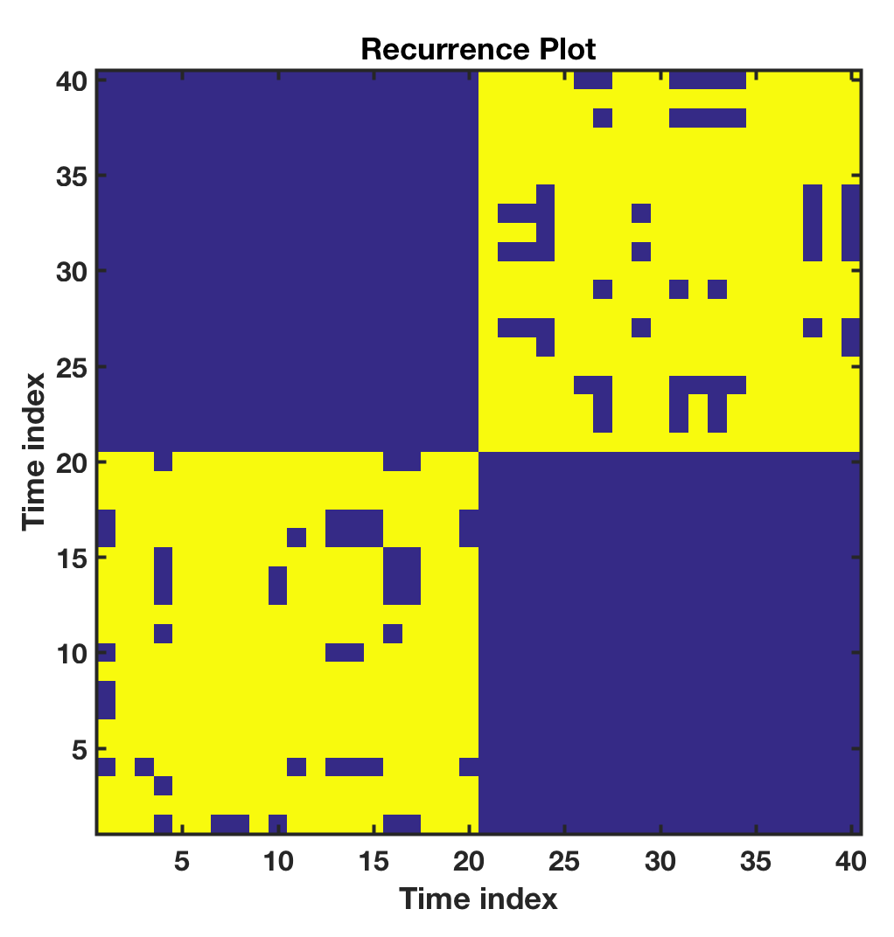
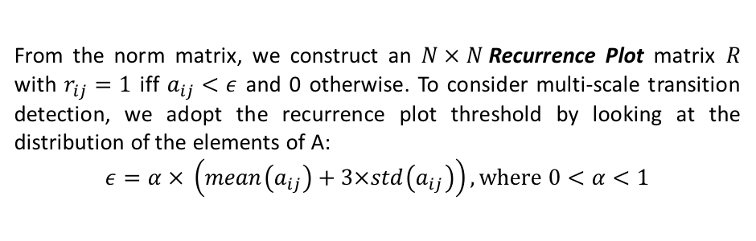
11.4 Recurrence Plot and Quadrant Scan to detect transition
From the norm matrix, we construct an $N × N$Recurrence Plot matrix $R$ with $r_{ij}=1$ iff $a_{ij}<ε$ and 0 otherwise. To consider multi-scale transition detection, we adopt the recurrence plot threshold by looking at the distribution of the elements of A:
$$ε=α × \left(mean\left(a_{ij}\right)+3×std\left(a_{ij}\right)\right), where 0<α<1$$
Michael Small, CSIRO & UWA

Slide 48
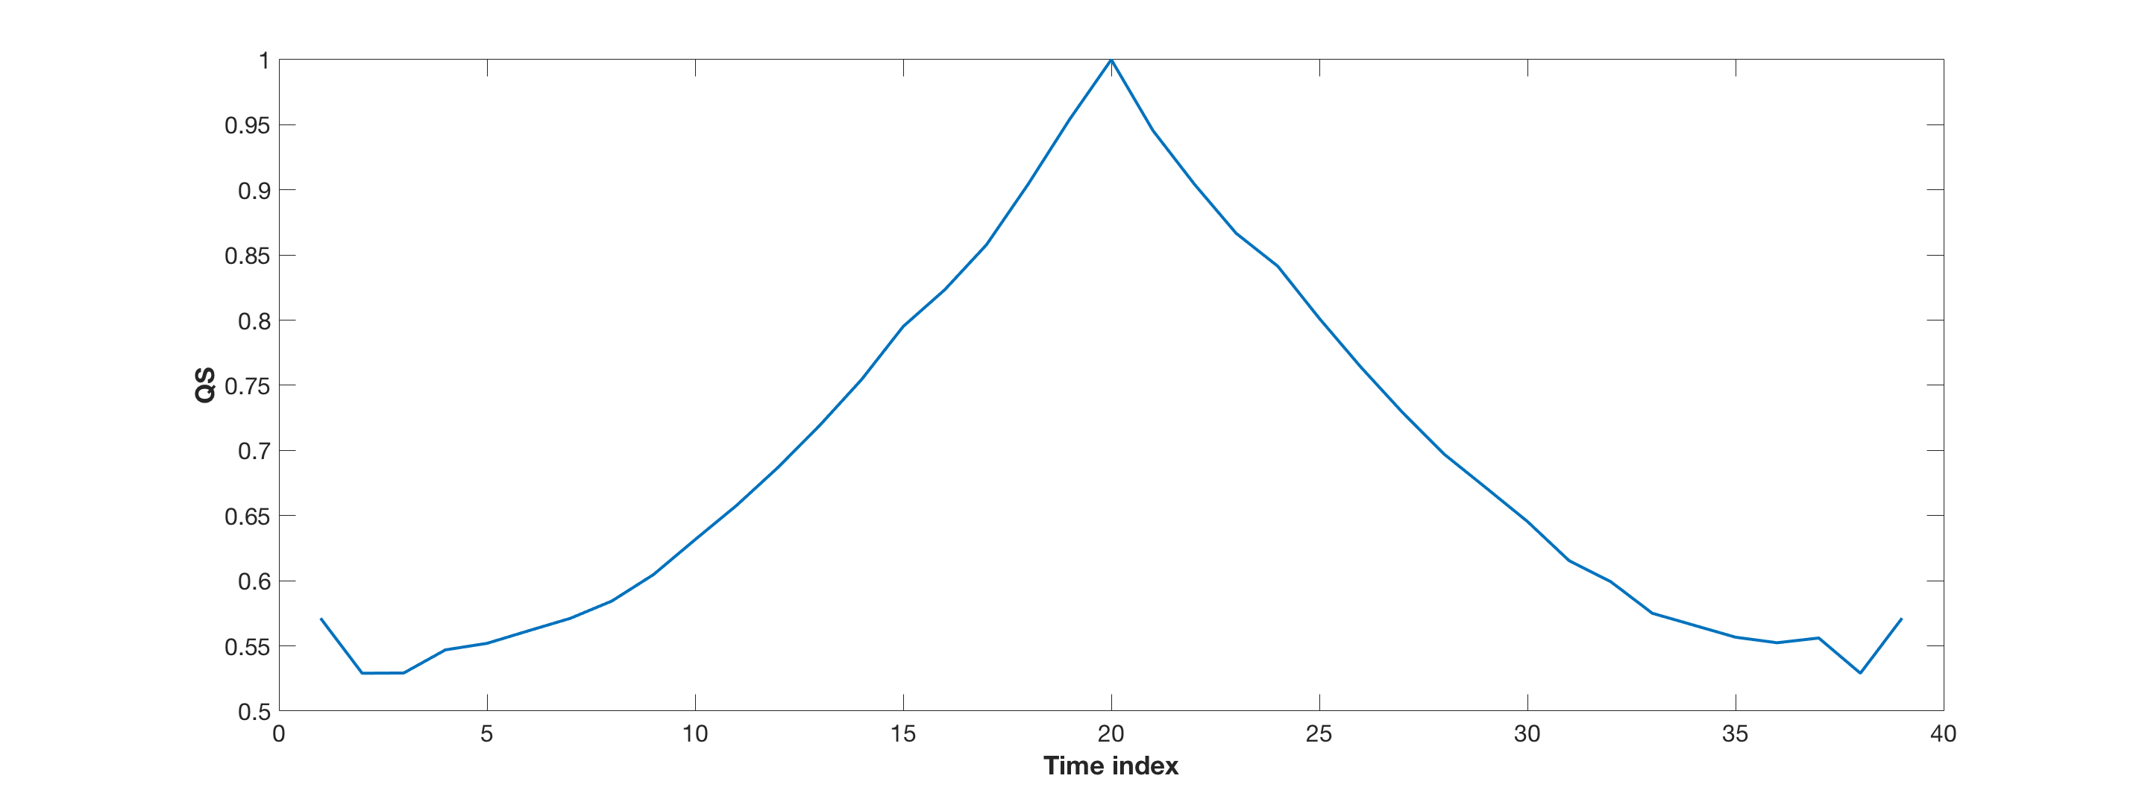
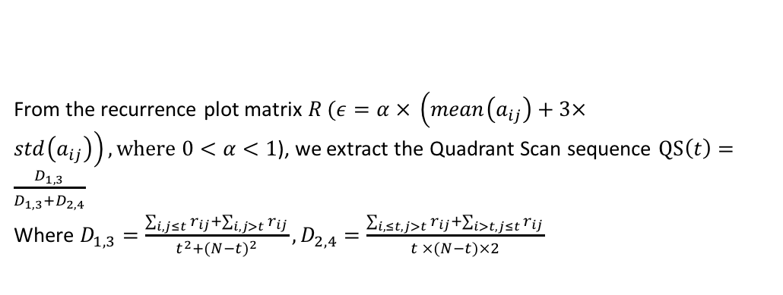
11.4 Recurrence Plot and Quadrant Scan to detect transition
From the recurrence plot matrix $R (ε=α × \left(mean\left(a_{ij}\right)+3×std\left(a_{ij}\right)\right), where 0<α<1$), we extract the Quadrant Scan sequence $QS\left(t\right)=\frac{D_{1,3}}{D_{1,3}+D_{2,4}}$
Where $D_{1,3}=\frac{\sum_{i,j≤t}{r_{ij}+\sum_{i,j>t}{r_{ij}}}}{t^{2}+(N−t)^{2}},D_{2,4}=\frac{\sum_{i,≤t,j>t}{r_{ij}+\sum_{i>t,j≤t}{r_{ij}}}}{t ×(N−t)×2}$
Michael Small, CSIRO & UWA

Slide 49
11.4 Recurrence Plot and Quadrant Scan to detect transition
4
3
1
2
From the recurrence plot matrix $R (ε=α × \left(mean\left(a_{ij}\right)+3×std\left(a_{ij}\right)\right), where 0<α<1$), we extract the Quadrant Scan sequence $QS\left(t\right)=\frac{D_{1,3}}{D_{1,3}+D_{2,4}}$
Where $D_{1,3}=\frac{\sum_{i,j≤t}{r_{ij}+\sum_{i,j>t}{r_{ij}}}}{t^{2}+(N−t)^{2}},D_{2,4}=\frac{\sum_{i,≤t,j>t}{r_{ij}+\sum_{i>t,j≤t}{r_{ij}}}}{t ×(N−t)×2}$
Michael Small, CSIRO & UWA

Slide 50
11.4 Recurrence Plot and Quadrant Scan to detect transition
4
3
1
2
From the recurrence plot matrix $R (ε=α × \left(mean\left(a_{ij}\right)+3×std\left(a_{ij}\right)\right), where 0<α<1$), we extract the Quadrant Scan sequence $QS\left(t\right)=\frac{D_{1,3}}{D_{1,3}+D_{2,4}}$
Where $D_{1,3}=\frac{\sum_{i,j≤t}{r_{ij}+\sum_{i,j>t}{r_{ij}}}}{t^{2}+(N−t)^{2}},D_{2,4}=\frac{\sum_{i,≤t,j>t}{r_{ij}+\sum_{i>t,j≤t}{r_{ij}}}}{t ×(N−t)×2}$
Michael Small, CSIRO & UWA

Slide 51
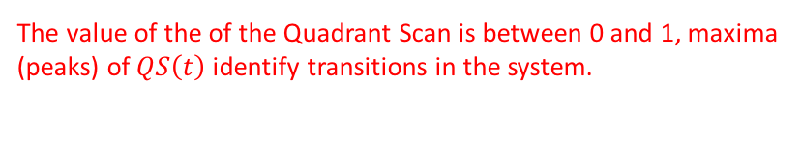
11.4 Recurrence Plot and Quadrant Scan to detect transition
4
3
1
2
From the recurrence plot matrix $R (ε=α × \left(mean\left(a_{ij}\right)+3×std\left(a_{ij}\right)\right), where 0<α<1$), we extract the Quadrant Scan sequence $QS\left(t\right)=\frac{D_{1,3}}{D_{1,3}+D_{2,4}}$
Where $D_{1,3}=\frac{\sum_{i,j≤t}{r_{ij}+\sum_{i,j>t}{r_{ij}}}}{t^{2}+(N−t)^{2}},D_{2,4}=\frac{\sum_{i,≤t,j>t}{r_{ij}+\sum_{i>t,j≤t}{r_{ij}}}}{t ×(N−t)×2}$
The value of the of the Quadrant Scan is between 0 and 1, maxima (peaks) of $QS\left(t\right)$identify transitions in the system.
Michael Small, CSIRO & UWA

Slide 52
11.4 Synthetic example of type 1 (state transition): Noisy stochastic system
Michael Small, CSIRO & UWA

Slide 53
11.4 Synthetic example of type 2 (dynamic transition): Noisy periodic system
Michael Small, CSIRO & UWA

Slide 54
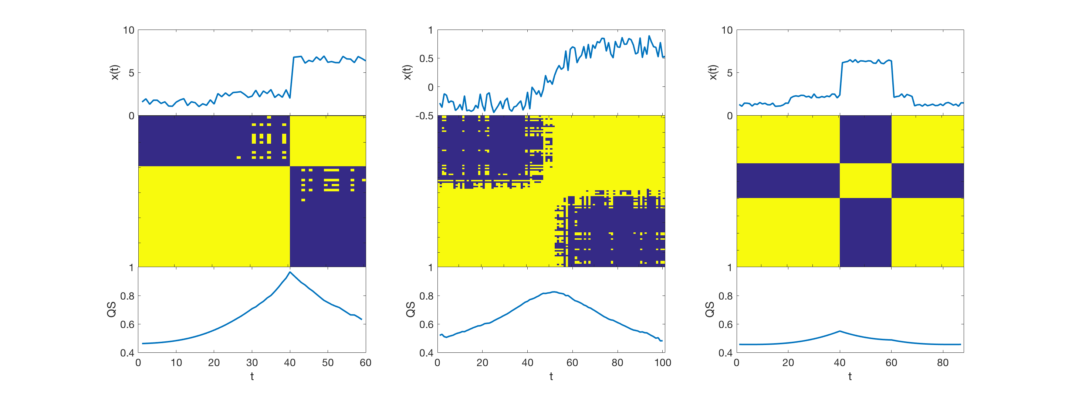
11.4 Testing different scenarios
Large threshold
Michael Small, CSIRO & UWA

Slide 55
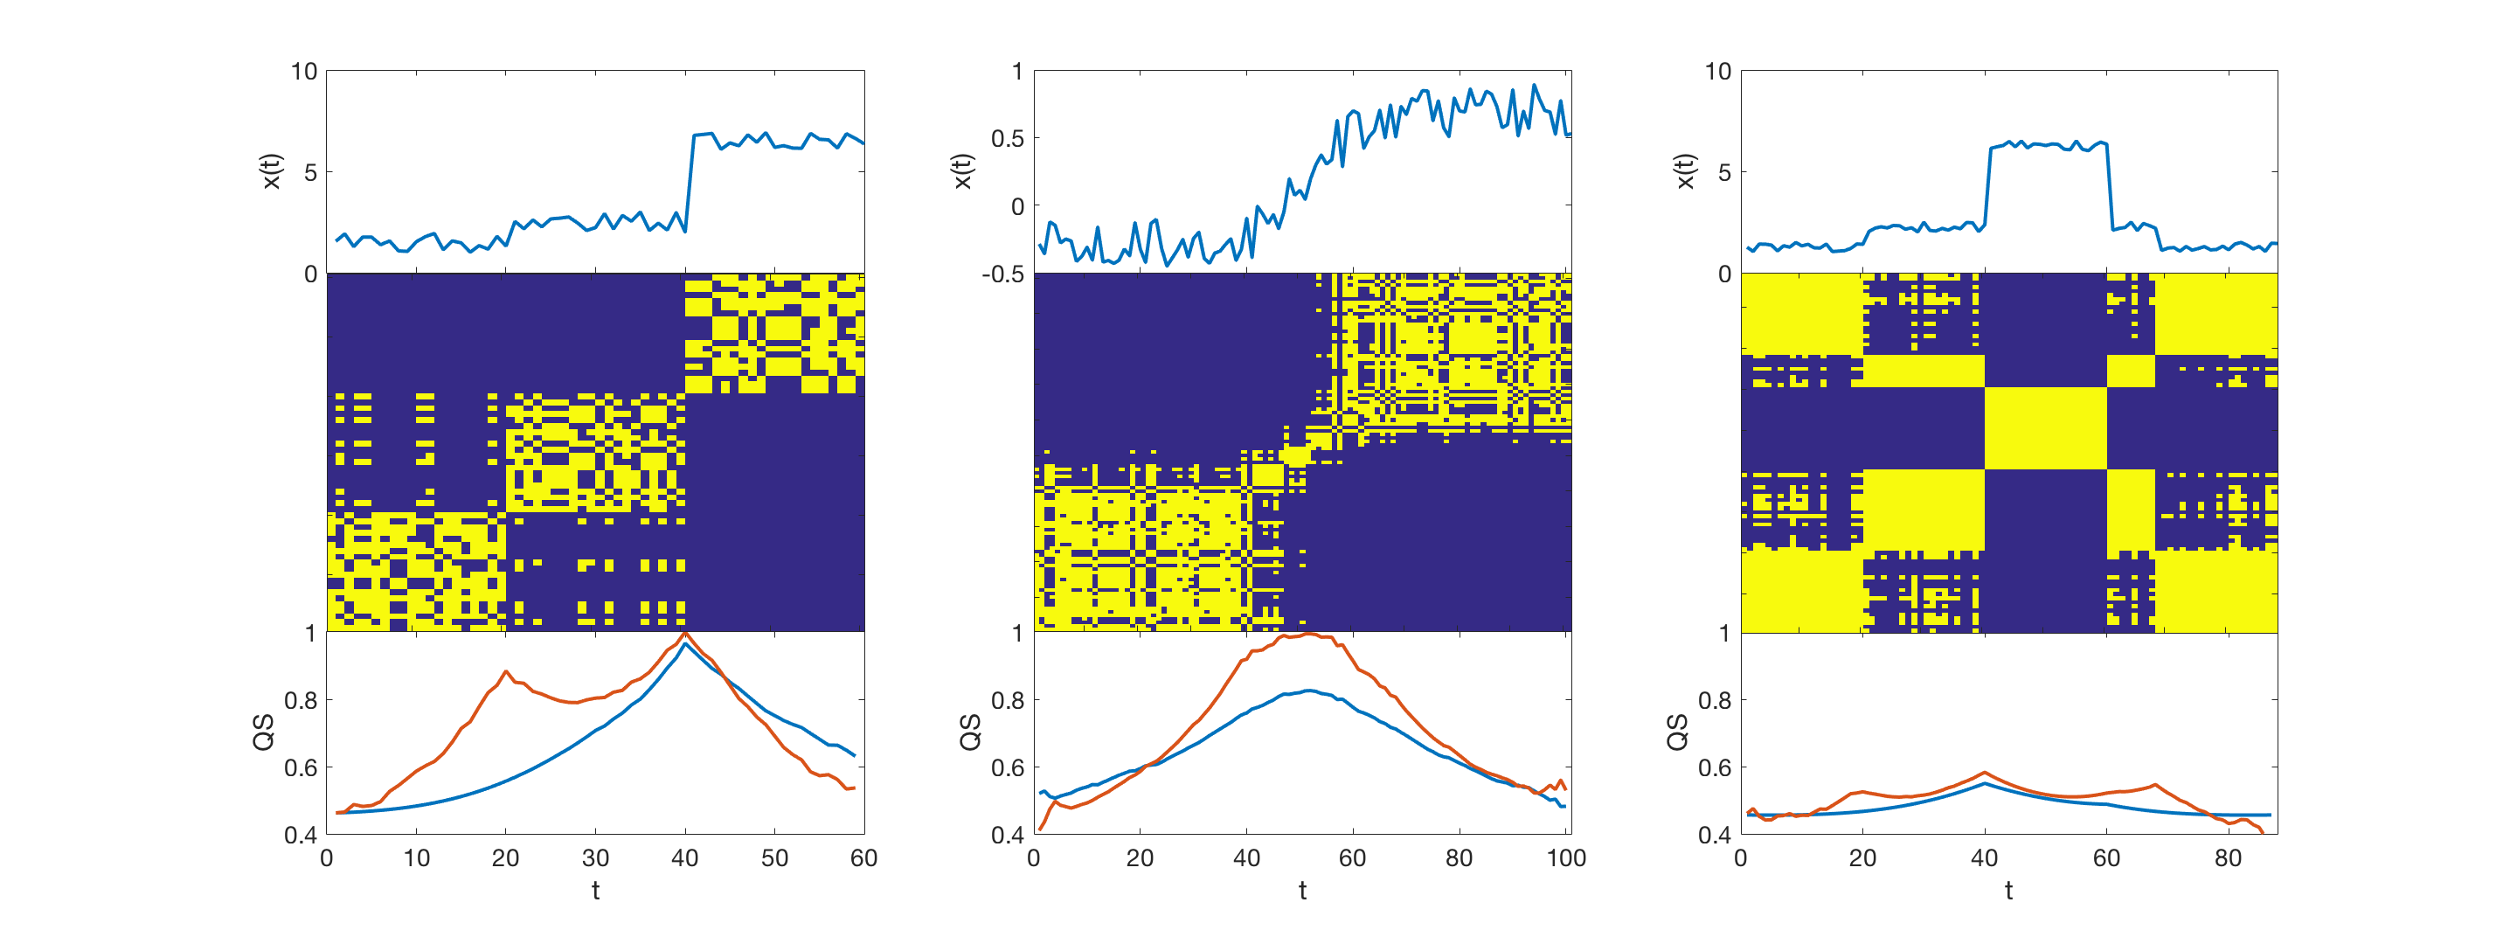
11.4 Testing different scenarios
Smaller threshold
Michael Small, CSIRO & UWA

Slide 56
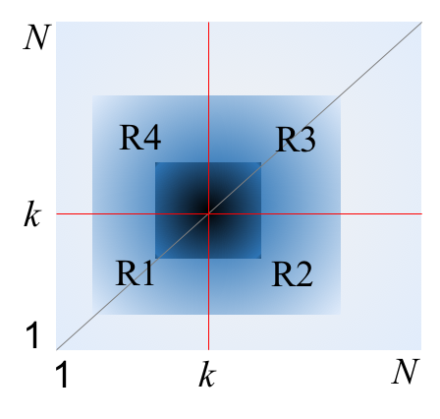
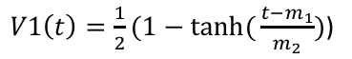
11.4 Weighted Quadrant Scan
$V1\left(t\right)=\frac{1}{2}(1−\tanh{(}\frac{t−m_{1}}{m_{2}})$)
Michael Small, CSIRO & UWA

Slide 57
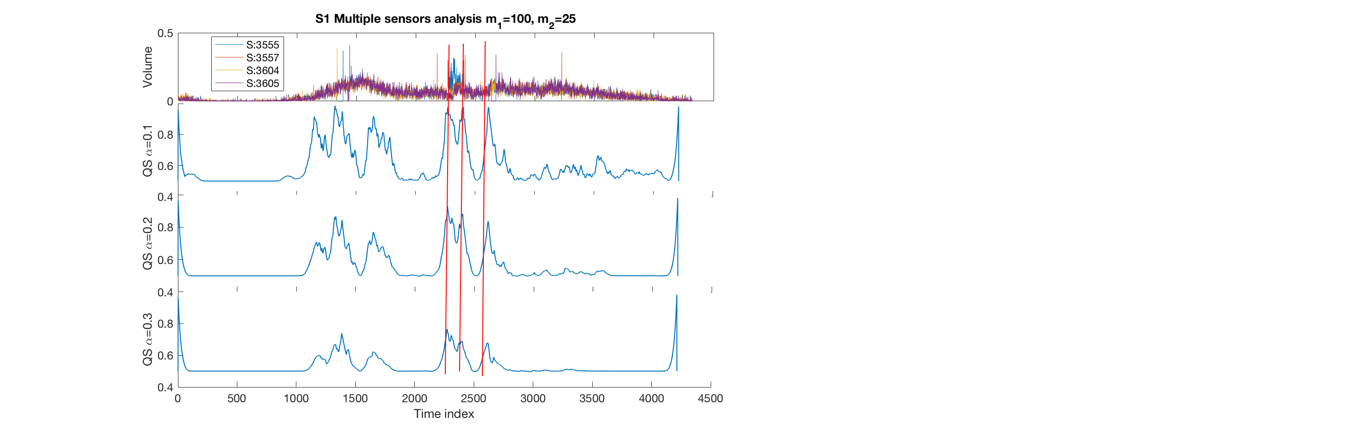
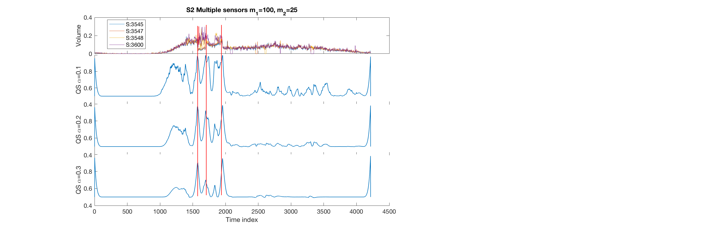
11.4 Real-world: Multivariate, noisy and nonstationary traffic data
Michael Small, CSIRO & UWA

Slide 58
11.4 Your turn
Case study
Layer detection in multivariate geophysical data
Refer to python notebook
Michael Small, CSIRO & UWA

Slide 59
11.4 Your turn
References
Zaitouny, A., Walker, D.M. and Small, M., 2019. Quadrant scan for multi-scale transition detection. Chaos: An Interdisciplinary Journal of Nonlinear Science, 29(10), p.103117.
Zaitouny, A., Small, M., Hill, J., Emelyanova, I. and Clennell, M.B., 2020. Fast automatic detection of geological boundaries from multivariate log data using recurrence. Computers & Geosciences, 135, p.104362.
Michael Small, CSIRO & UWA

